Slide 1

https://www.uni-goettingen.de/en/48115.html
PopGen_Ch-8
Population Genetics; Equilibria (Selection-Drift, Selection-Mutation)
1

Slide 2
Sequential Number: #9
UNPLAB-PopGen_Ch-8[Equil]
2

Slide 3

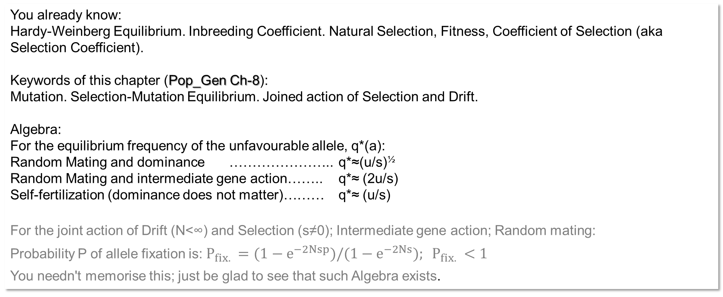
You already know:
Hardy-Weinberg Equilibrium. Inbreeding Coefficient. Natural Selection, Fitness, Coefficient of Selection (aka Selection Coefficient).
Keywords of this chapter (Pop_Gen Ch-8):
Mutation. Selection-Mutation Equilibrium. Joined action of Selection and Drift.
Algebra:
For the equilibrium frequency of the unfavourable allele, q*(a):
Random Mating and dominance ………………….. q*≈(u/s)^{½}
Random Mating and intermediate gene action…….. q*≈ (2u/s)
Self-fertilization (dominance does not matter)……… q*≈ (u/s)
For the joint action of Drift (N<∞) and Selection (s≠0); Intermediate gene action; Random mating:
Probability P of allele fixation is: ${P_{fix. }=(1−e}^{−2Nsp})/{(1−e}^{−2Ns}); P_{fix. }<1$
You needn't memorise this; just be glad to see that such Algebra exists.
3

Slide 4
Hardy-Weinberg Equilibrium is an anchor setting in Population Genetics and Plant Breeding, although it is a theoretical concept. It is very useful to compare experimental findings with parameter values expected at HWE status (Inbreeding status, genotype and allele frequencies, LD status).
Self-fertilization (and any other type of inbreeding) causes violations of HWE.
Drift is a violation of HWE.
Selection (natural, human) is as well violating (the basic assumptions for) HWE.
Migration is a violation of HWE. Migration may cause the frequency of allele ‘a’ or ‘A’ to increase or may even alter the situation at a locus from monomorphic to polymorphic; may even introduce a third allele such as allele ‘α’; all these will as consequence change P(AA) et cetera, and hence violate HWE.
This sentence is all I say here. ;-) to migration.
Yet, visit Holsinger‘s website for more.
https://kholsinger.github.io/statistical-population-genomics/
Mutation is such violation (‚no Mutation‘ is one of the core assumptions for HWE).
4

Slide 5
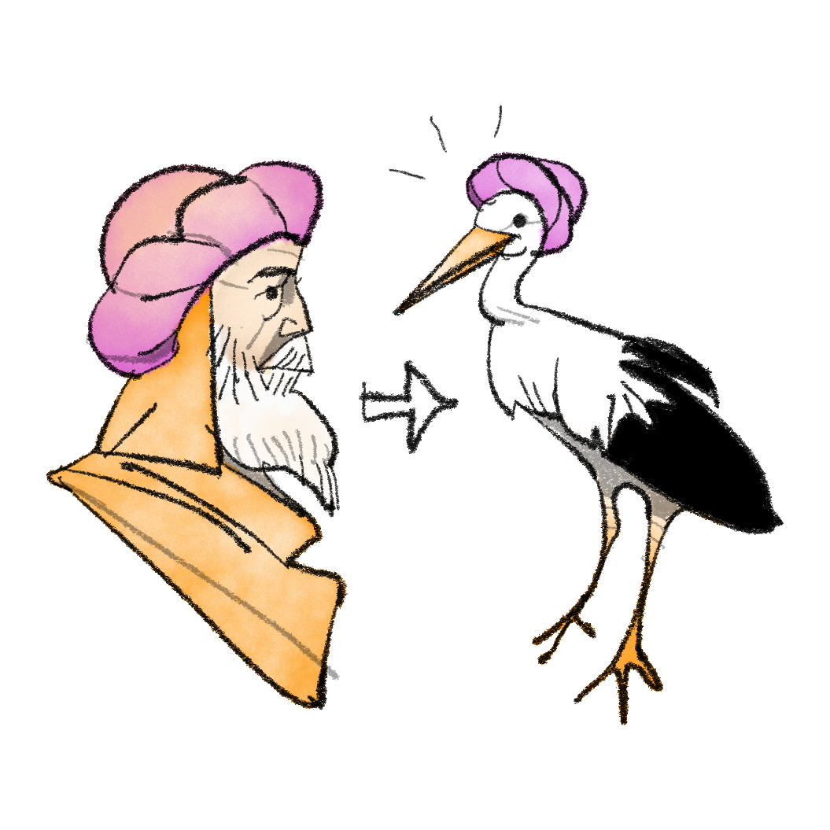
Mutation. ‚Mutabor‘ is the magic spell in the fairy tale ‘Kalif Storch’.
The magician Kaschnur transforms the caliph Chasid into a stork.
https://de.wikipedia.org/wiki/Die_Geschichte_von_Kalif_Storch
The latin word mutationem means ‘change’ and is part of the magic spell Mutabor, as well as of the genetic term Mutation.
It warns us that something new arises and we have to wait and see whether it will be good or bad (or rather neutral).
© Henri Laugel
Don't worry, Chasid of Bagdad didn't have to stay a stork: He had to let go some of his pride, then an ugly owl saved him with the right wink. Besides, there was a happy ending with wedding and so on.
5

Slide 6
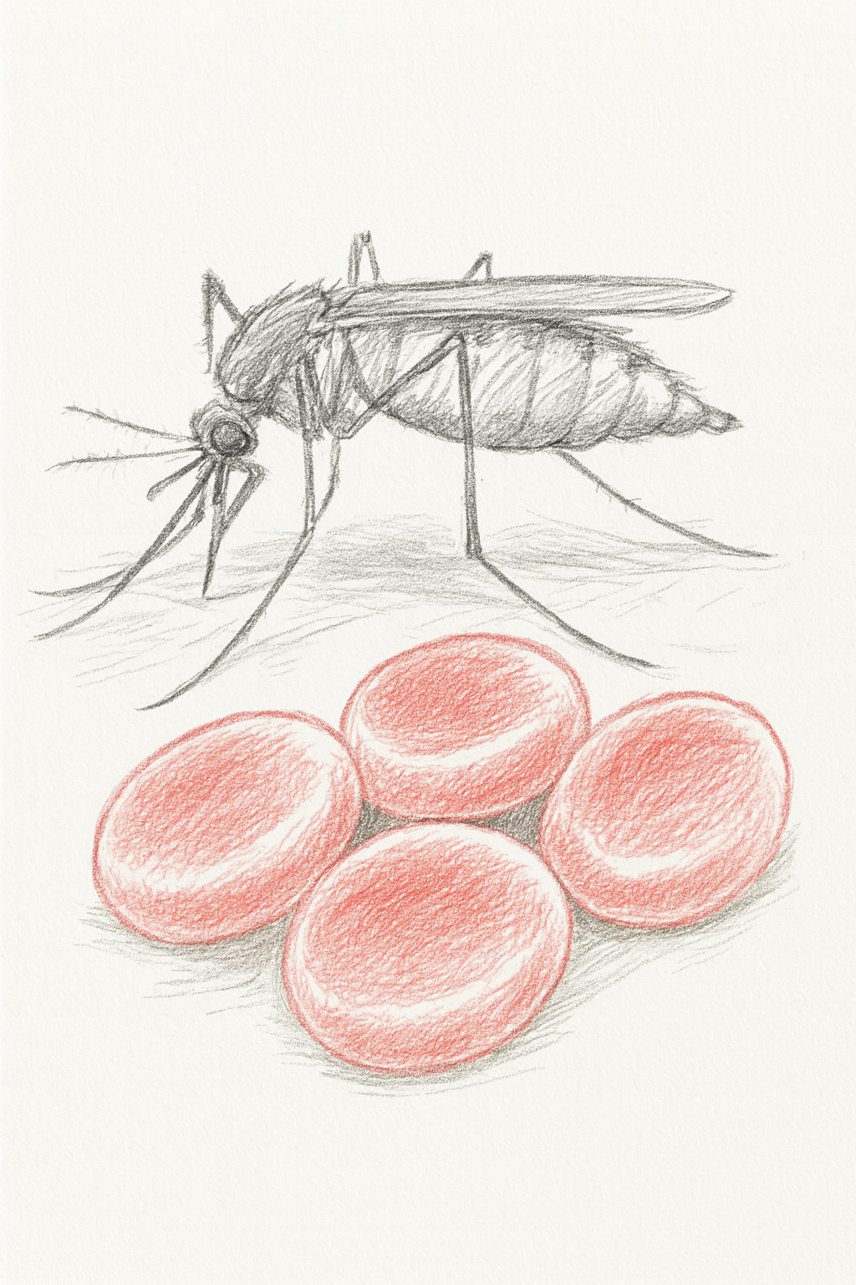
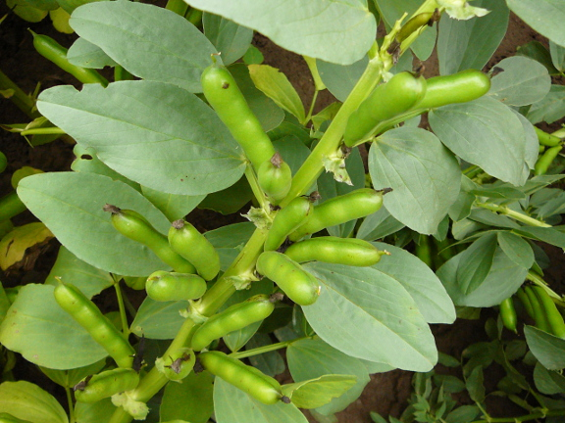
Mutation. As example we take the story of Vicine-convicine in faba bean
At the Northern tip (joke) of the first chromosome of Vicia faba (faba bean), we find the genetic locus where RIBA1 is coded. If homozygous for the mutant allele vc1 of RIBA1, faba bean plants show only about 5% of the ‚normal‘ seed content of Vicine and Convicine (~0.05% rather than ~1%). These compounds are anti-nutritive. On the human X-chromosome (near the telomeric region of the distal arm of that chromosome … whatever ;-) this may mean) we find the locus where Glycose-6-phosphate-dehydrogenase (G6PD) is coded. There is a plethora of rare mutants in Homo sapiens at that locus. Mutated alleles of G6PD cause sensitivity upon ingestion of Vicine and Convicine.
This is called ‘favism’; it may be dangerous (to red blood cells), symptoms are similar to jaundice. Nevertheless, the (indirect) effect of G6PD deficiency is usually more dangerous to Malaria plasmodia in human blood – if they are there – than to the red blood cells and thus to the human individual itself.
We have here an intricate inter-play between mutant alleles in faba bean and mutant alleles in humans eating Vicine-Convicine-containing faba beans, and the parasite Malaria (genetic diversity on the Malaria side may exist, too; yet I have no clue). Consequently, people with a G6PD mutation are predominantly found in regions with a current or historical incidence of malaria. We see the consequences of selection for survival and fitness of humans in case of co-occurrence of malaria and faba bean.
Vicia faba, a plant of
faba bean
© Marzinzig
6

Slide 7
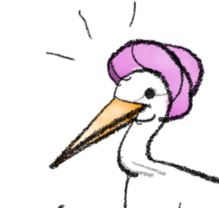
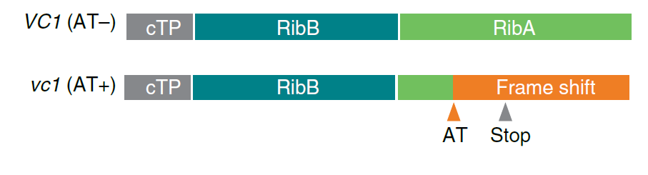
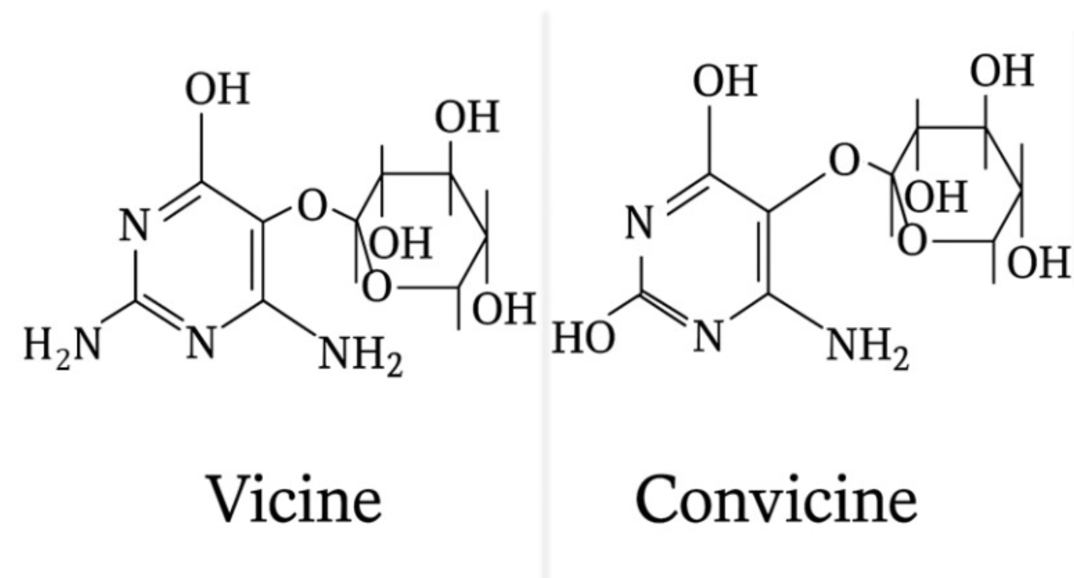
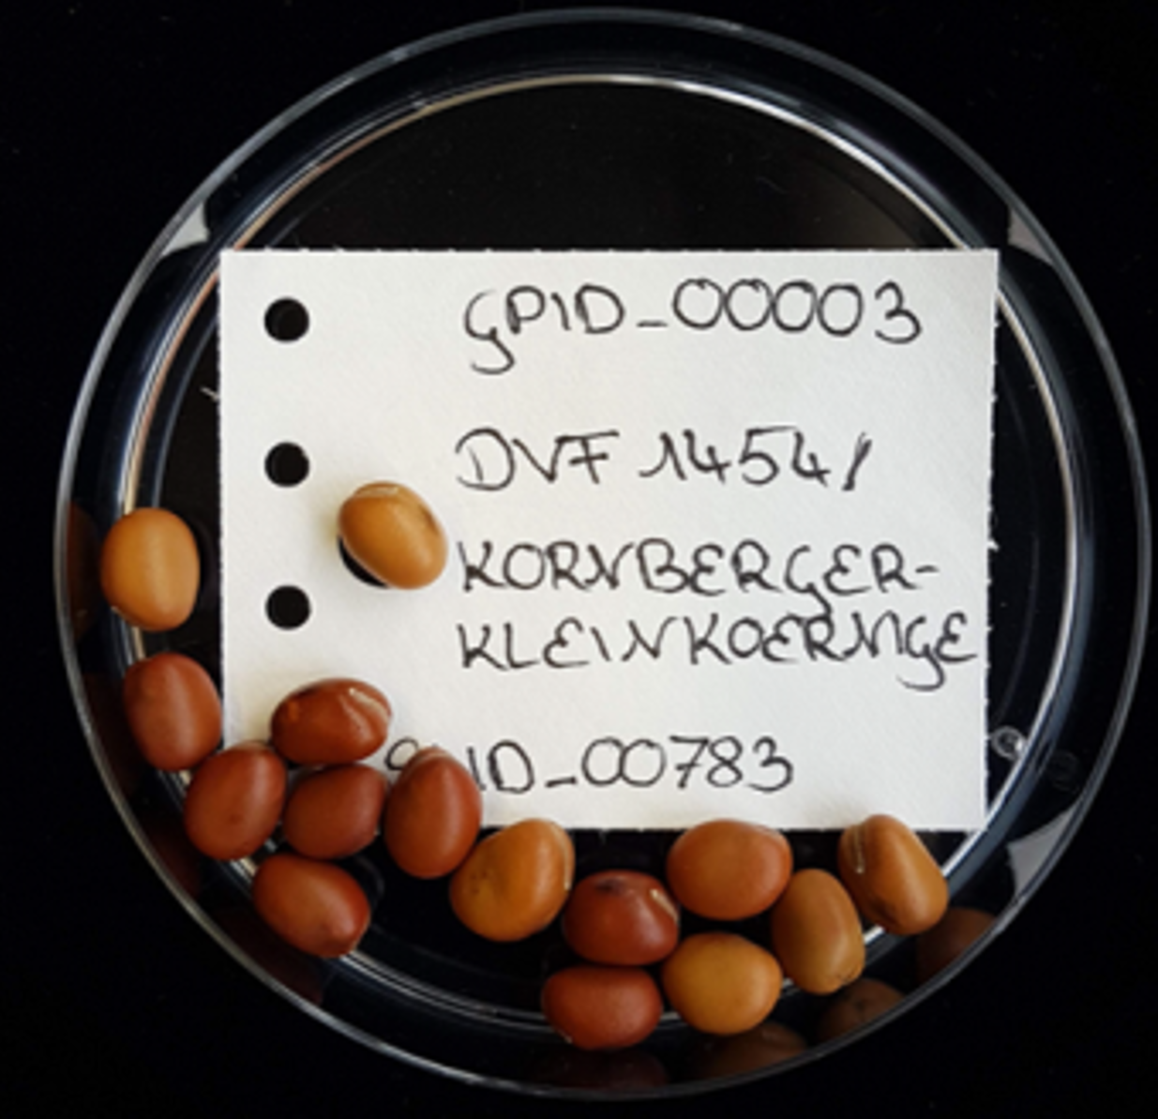
Mutation.
3,4-dihydroxy-2-butanone 4-phosphate synthase /
Guanosintriphosphate cyclohydrolase II
This locus and its two alleles ‚explain‘ about ¾ of the variance for Vicine-and-Convicine seed content. The remaining ¼ of the variance is explained by minor alleles (‚genetic background‘).
DOI 10.1007/s11032-015-0214-8
DOI 10.5073/JfK.2022.01-02.01
DOI 10.3389/fpls.2025.1565210
This research is in progress, may be you want to join?
The normal, wild-type allele VC1 and the mutant,
deviant allele vc1 coding for (versions of) RIBA1 enzyme.
Björnsdotter et al., 2021
© Marzinzig
© Windhorst
7

Slide 8
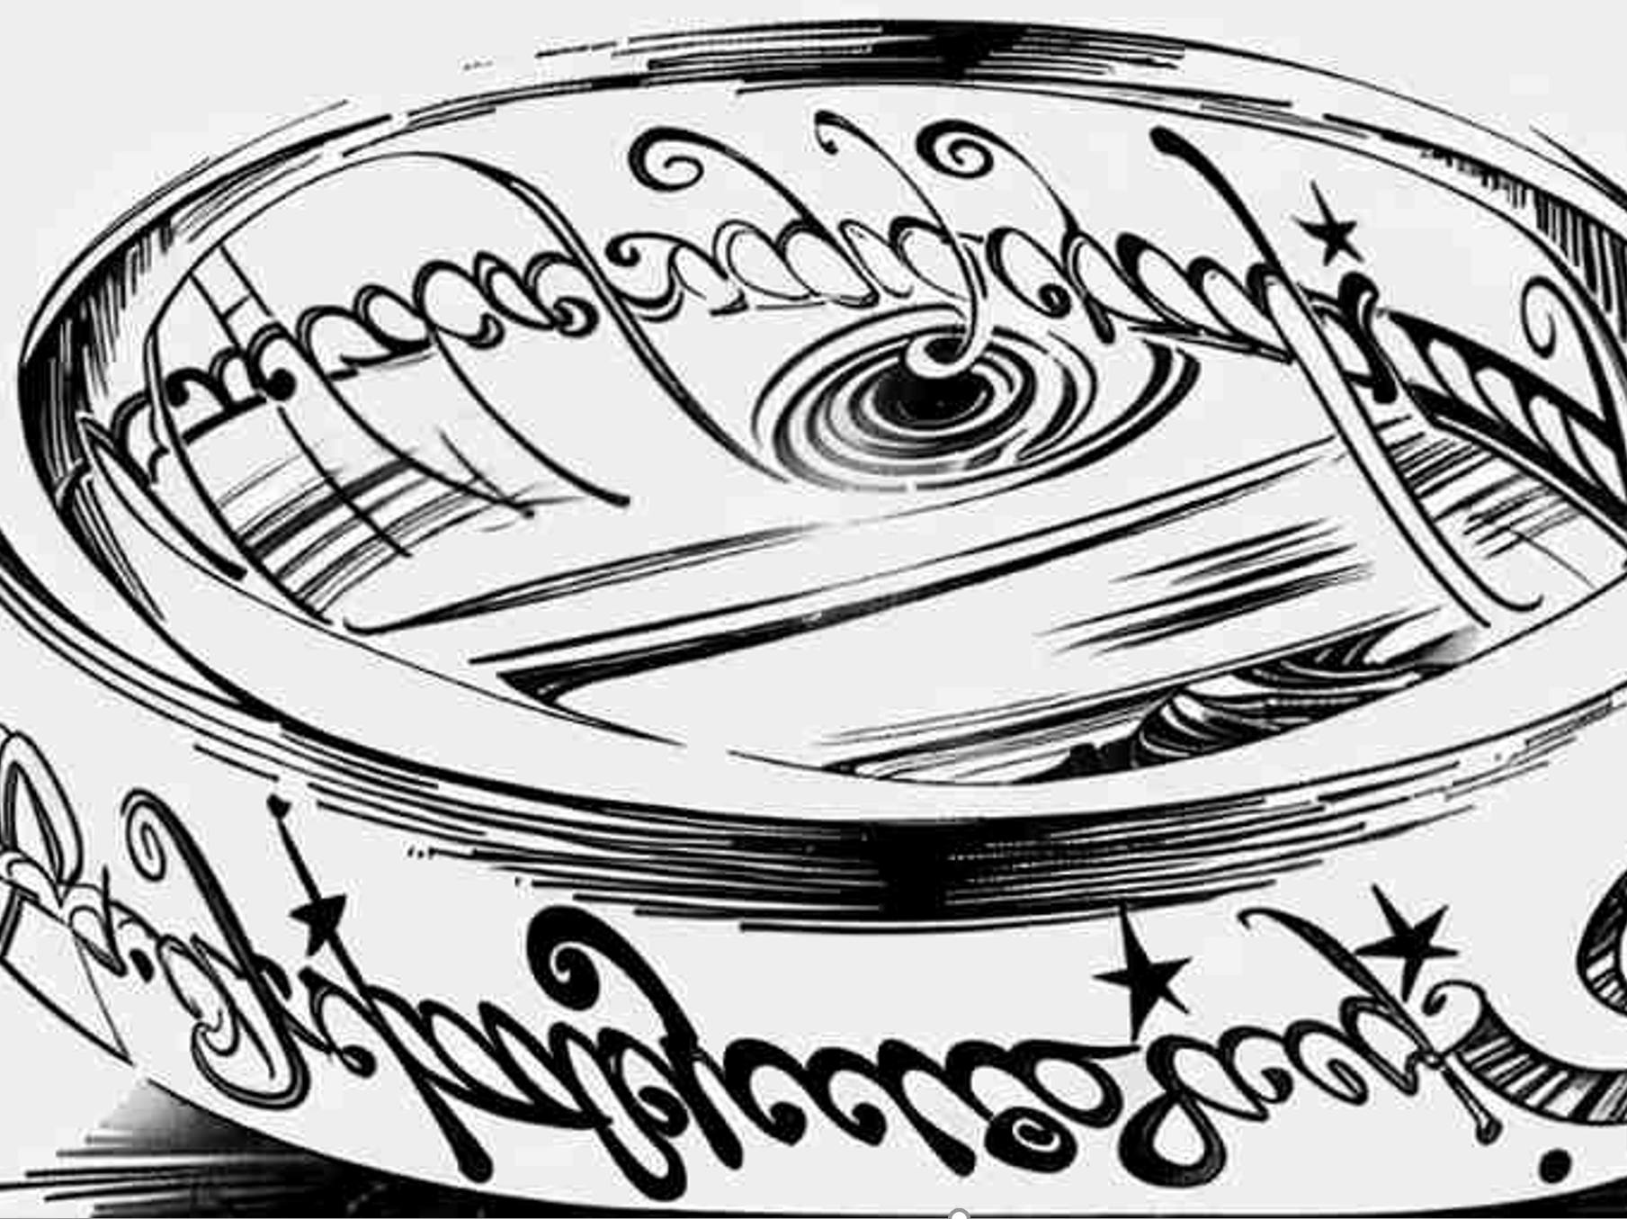
Mutations and mutation rate u.
8
In the book.
.. Elrond, Lord of Rivendell, Elf, musing, talking to himself at the White Council: “The road must be trod, but it will be very hard. And neither strength nor wisdom will carry us far upon it. This quest may be attempted by the weak with as much hope as the strong. Yet such is oft the course of deeds that move the wheels of the world: small hands do them because they must, while the eyes of the great are elsewhere.”
In the movie.
Galadriel, Lady of Lórien, Elf, talking to Frodo Baggins at Galadriel’s mirror:
“Even the smallest person can change the course of the future.”
Mutation is a weak force among the forces that shape the fate of populations; yet, on long scale it creates the main resource for Evolution. We see point mutations, insertions, deletions, translocations, ploidy changes.
Mutations occur very rarely (u is ~10⁻⁴ or much less per gene & per generation). They occur spontaneously; random Mutations can be released by chemical treatment or by treatment with e.g. X-rays (such Mutations can not be steered as to where and what). Most point mutations are with no effect. Often they happen to occur in the intergenic space or in introns; or the resulting triplet is synonymous (CAA ► CAG; both code for glutamine). Yet, Mutations that change amino acids and – especially – if they cause ‘frame shifts’ or introduce DNA-stop codon triplets (e.g. TAG) – such Mutations cause (mostly destructive) phenotypic effects. The effects are typically causing recessive gene action (impair or nullify the function of the coded protein). Here, we take a Mutation as monogenic, Mendelian genetic factors; a mutation event transforms one allele of a gene into an other allele of that gene. Site directed Genome Editing (for instance via CrispR Cas) is a modern set of techniques which allow to change DNA-sequences at will (to edit the ‚text‘; DOI 10.1111/jbg.12344; https://www.ft.com/content/db37645e-777f-440f-b4a6-e0a6b53f8b30).

Slide 9
Kids create disorder in the children‘s room, parents clean up, result is an Equilibrium.
Take an easy situation. The frequency of a Mutation to occur be u <<<1, the frequency of Reverse Mutation (‘undo’) be u=0. Mutations are rare! Frequen-cies are not so well studied in plants. Estimates are like 5∙10⁻⁴ to 8∙10⁻⁵ Mutations – yet you have to be cautious. Usually the figures are per locus and per generation and per individual, but not always so
(https://www.spektrum.de/lexikon/biologie/mutationsrate/44515;
DOI 10.1093/genetics/148.4.1667).
Other estimates are much lower, such as in the insect D. melanogaster, where an estimate was 8.5∙10^{–9} (DOI 10.1038/nrg2158). Obviously, Mutation alone is a weak force and will change allele and genotype frequencies only in the very long run.
Reminder: The ‚normal‘ allele may be called wild-type allele as contrast to the mutated allele. This notation even applies in non-wild, domesticated species.
If Mutation and Selection co-occur and influence a population, a balance between both forces can be expected ...
S
M
Migration and Selection can occur jointly.
Migration and deviation from random mating may occur simultaneously. Inbreeding and Selection can happen at the same time.
Drift and Mutation happen together.
Migration may happen as Drift and Selection co-occur. Et cetera.
Here and below, we only study two cases of co-occurrences:
● Selection and Mutation
● Selection and Drift
9

Slide 10
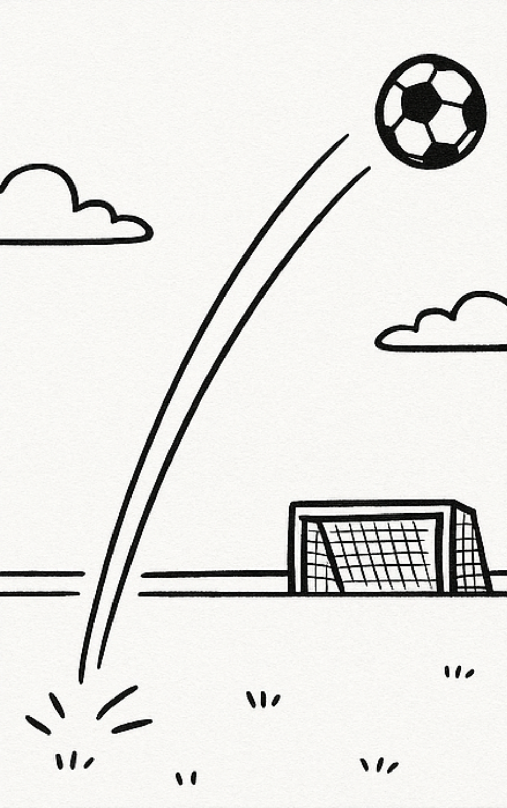
Kids create disorder in the children‘s room, parents clean up, result is an Equilibrium.
If Mutation and Selection co-occur and influence a population, a balance between both forces can be expected (just like the level of disorder in the children’s room as the result of the two opposite-directed powers).
Mutated alleles usually cause reduced fitness. Therefore
selection tends to ‘kick’ such alleles out of the population$,
whereas Mutation (from time to time) creates them afresh.
The equilibrium frequencies q* of this balance between
Mutation and Selection depends on the Mutation rate u, on
the Selection coefficient s, on the level of dominance of the
wild-type allele and on the reproductive mode.
$Be cautious! This is jargon. Natural ‘Selection’ is not a person, is not ‘doing’ anything. What is honestly meant is: Alleles that ‘cause’ reduced fitness will become steadily rarer across generations ... caused by ‘their’ reduced fitness. No active looking-for-them and no active kicking-them-out. This latter is what breeders (attempt to) do, i.e. artificial selection.
S
M
Migration and Selection can occur jointly.
Migration and deviation from random mating may occur simultaneously. Inbreeding and Selection can happen at the same time.
Drift and Mutation happen together.
Migration may happen as Drift and Selection co-occur. Et cetera.
Here and below, we only study two cases of co-occurrences:
● Selection and Mutation
● Selection and Drift
10
‚kick out‘

Slide 11
Mutation-Selection Equilibrium depends on u, s, gene action and reproductive mode
Algebra for the equilibrium frequency of the unfavourable allele, q*(a).
Random mating and dominance ………………….. q*≈(u/s)^{½}
Random mating and intermediate gene action…….. q*≈ (2u/s)
Self-fertilization (dominance does not matter)……… q*≈ (u/s)
Assume a Mutation rate of u=10⁻⁴, a selection coefficient of s=0.5.
Then:
Random mating and dominance ………………….. q*≈0.014 (1.4%)
Random mating and intermediate gene action …….. q*≈ 0.004 (0.4%)
Self-fertilization (dominance does not matter) ……… q*≈ 0.002 (0.2%)
Thus, even in the long run, and especially under Random Mating and dominant-recessive gene action, deleterious recessive alleles stay in the population in noteworthy amount ► Genetic Load. O
n a short time
S
M
Mutation rate ........ u
Selection coefficient .. s
Equilibrium frequency
of allele a ........... q*
11

Slide 12
Mutation-Selection Equilibrium depends on u, s, gene action and reproductive mode
Algebra for the equilibrium frequency of the unfavourable allele, q*(a).
Random Mating and dominance ………………….. q*≈(u/s)^{½}
Random Mating and intermediate gene action…….. q*≈ (2u/s)
Self-fertilization (dominance does not matter)……… q*≈ (u/s)
Assume a mutation rate of u=10⁻⁴, a selection coefficient of s=0.05.
Then:
Random mating and dominance ………………….. q*≈ 0.0141 (1.41%)
Random mating and intermediate gene action …….. q*≈ 0.0004 (0.04%)
Self-fertilization (dominance does not matter) ……… q*≈ 0.0002 (0.02%)
Thus, even in the long run, and especially under Random Mating and dominant-recessive gene action, even markedly deleterious recessive alleles stay in the population in noteworthy amount ► Genetic Load.
Mutation is weak on a short time scale, but decisive as source of novel genetic variation. With a mutation rate of u=10⁻⁴ per gene and N=10⁴ individuals in a population ... ► one Mutation per focal gene. Yet, you have to find the concerned plant, and the Mutation may not be the desired one ☺.
S
M
12
Mutation rate ........ u
Selection coefficient .. s
Equilibrium frequency
of allele a ........... q*

Slide 13
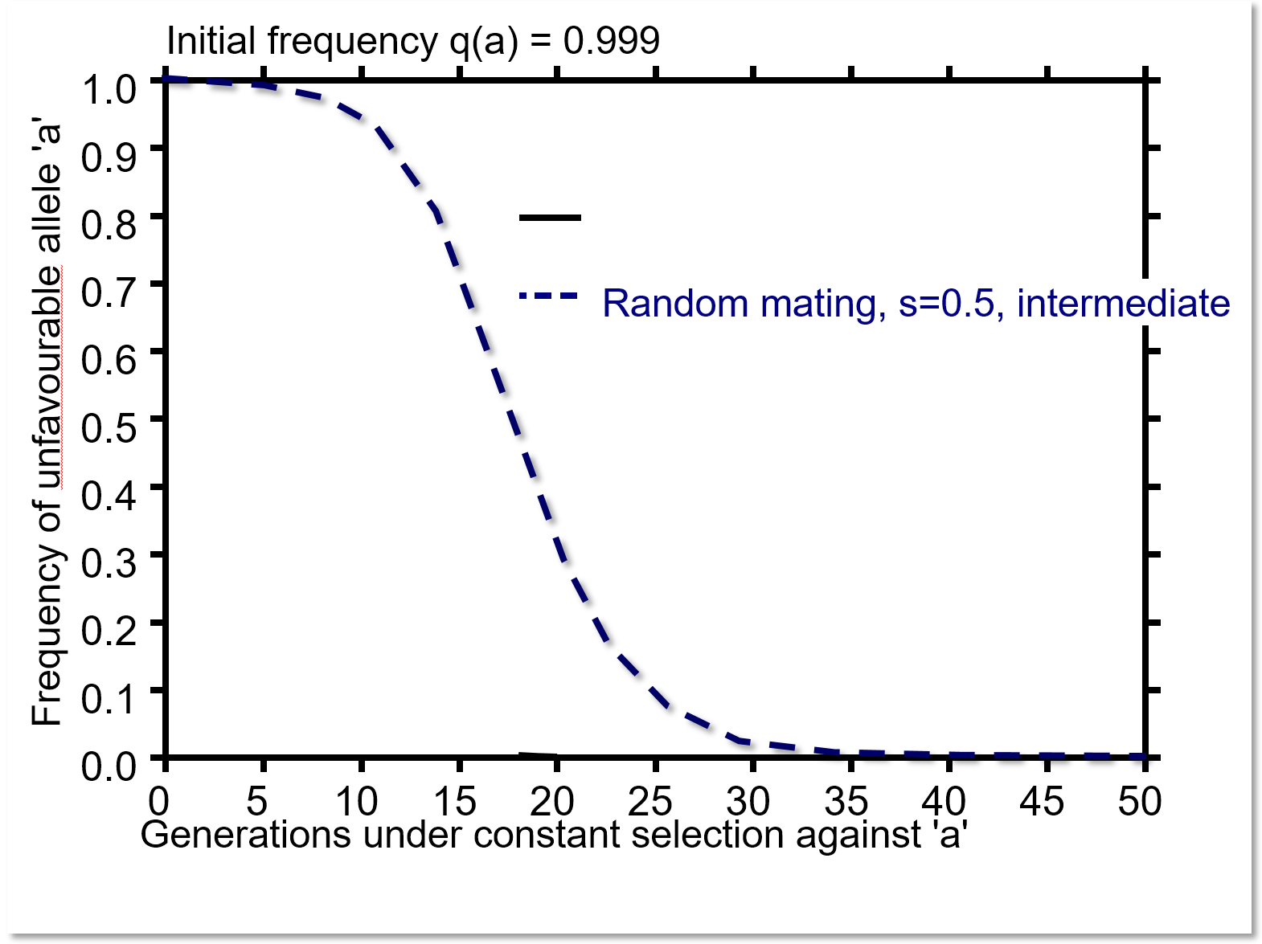
Mutation-Selection equilibrium with Random Mating and intermediate gene action & u
We compare the ongoing reduction of q(a) if u=0 with u=0.0001. Here, as example, in case of Random Mating, the un-favourable allele is intermediate (even the ‘Aa’ genotype suffers - half as much as ‚aa‘ - from the fitness penalty; s=0.5).
In generation 50, with u=0, the strongly unfavourable allele a is (nearly) kicked out, its frequency is nearly zero.
Yet, with u=0.0001, in generation 50, q(a) nearly reaches the equilibrium frequency of 4 in 10.000 (q*=0.4 ‰). This is a relatively high frequency, seeing the strong value of s=0.5. Yet, with q*= 0.4 ‰, only ~8 individuals in 10.000 show genotype ‘Aa’ (their fitness reduced by 25%); and about ~nobody is ‘aa’ (q² = 16∙10⁻⁸).
If it was ‘Selfing’ thus homozygosity of ‚everybody‘, then q* = 0.2 ‰, thus 2 individuals in 10.000 would show the full fitness reduction of s=0.5 (instead of 8 in 10.000 showing half-penalty of s=0.25).
R. mating, interm.; s=0.5; u=0.0
R. mating, interm.; s=0.5; u=0.0001
q*=(appr.) 2u/s = 0.0004
0.0004
13

Slide 14
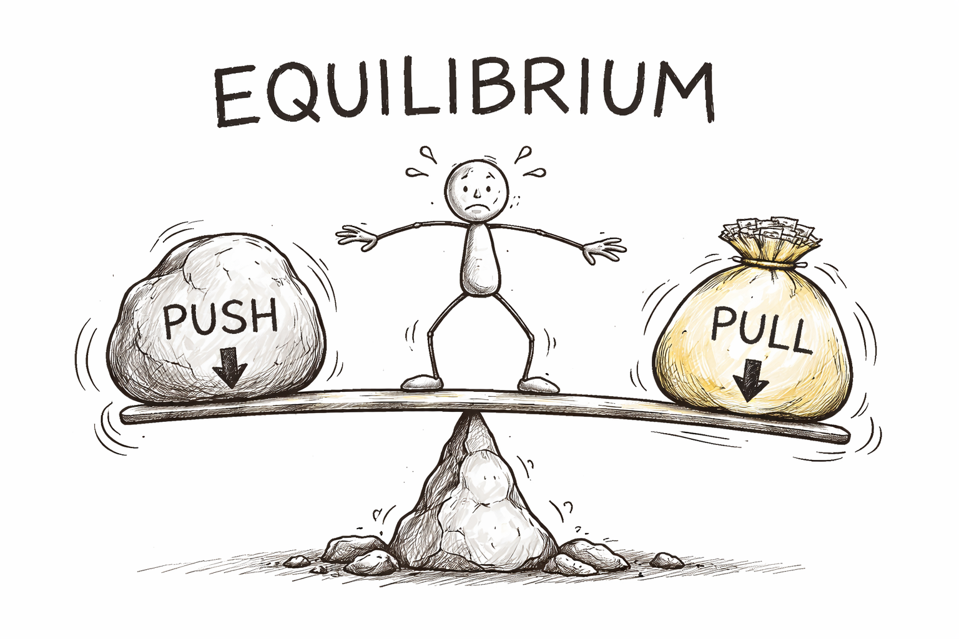

It is all happening ...
... in our head ;-)
14

Slide 15

After
Mutation-and-Selection balance (equilibrium) we now inspect the outcome of joint action of Drift and Selection.
With pure Drift (I want to say: with Random Drift alone, and no Selection; s=0; and no ... you know no Migration, Random Mating), we learnt as message:
„The probability P that an allele A₁ is ultimately fixed in the course of Random Drift is identical with its initial frequency p_{initial}(A₁).
P_{fix}(A₁) = p_{initial}(A₁) //you may re-visit UNPLAB-PopGen_Ch-4[Drift I] page 27//
Next page (Drift and Selection) we have a different message.
„We start with a superior allele entering the population in minimum dose of
p(A₁) = $\frac{1}{2N}$. With simultaneous Random Drift and Selection, the probability that this superior allele A₁ is ultimately fixed is (under some condition) equal to s.
P_{fix}(A₁) = s
I use ’Drift‘, ‘Genetic Drift‘, ‘Random Drift‘, ‘Random Genetic Drift‘ as synonyms.
15

Slide 16
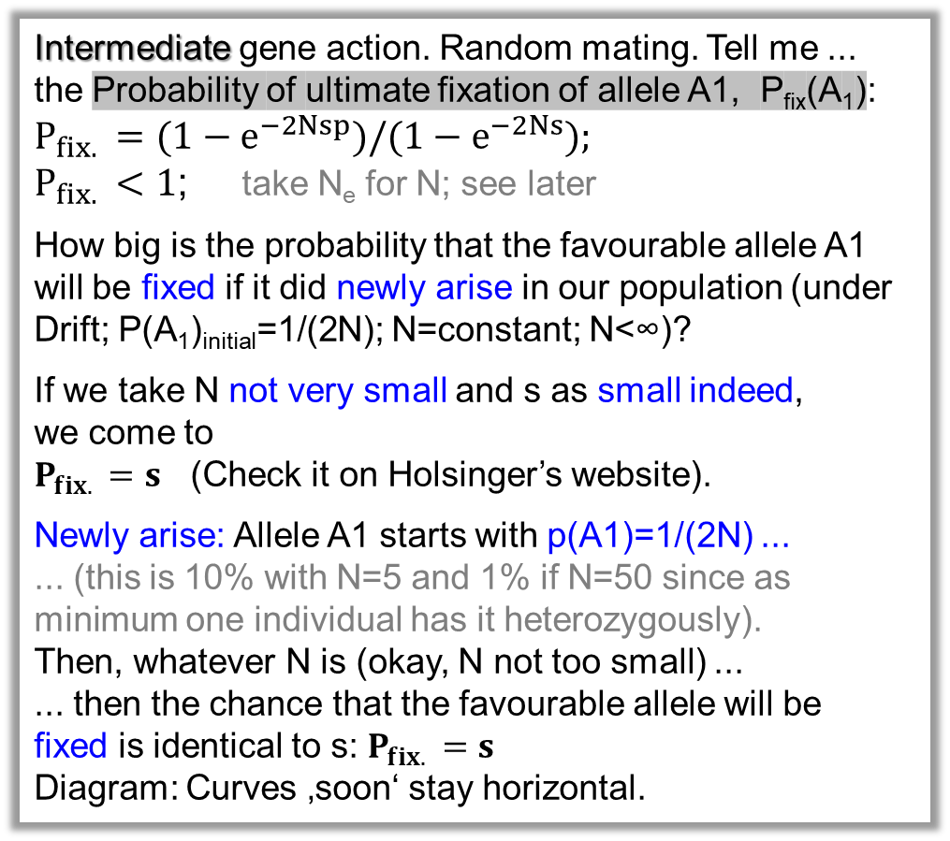
An excellent teacher of Population Genetics: Kent Holsinger, Connecticut, USA. www.academia.edu/2808838/Lecture_Notes_in_Population_Genetics
Superior allele A₁ is initially rare, only 1 in N has it, and only heterozygously, hence P(A₁)_{initial}=1/(2N).
Intermediate gene action. Random mating. Tell me ...
the Probability of ultimate fixation of allele A1, P_{fix}(A₁):
$${P_{fix. }=(1−e}^{−2Nsp})/{(1−e}^{−2Ns});$$
$P_{fix. }<1$; take N_{e} for N; see later
How big is the probability that the favourable allele A1 will be fixed if it did newly arise in our population (under Drift; P(A₁)_{initial}=1/(2N); N=constant; N<∞)?
If we take N not very small and s as small indeed,
we come to
$P_{fix. }=s$ (Check it on Holsinger’s website).
Newly arise: Allele A1 starts with p(A1)=1/(2N) ...
... (this is 10% with N=5 and 1% if N=50 since as minimum one individual has it heterozygously).
Then, whatever N is (okay, N not too small) ...
... then the chance that the favourable allele will be
fixed is identical to s: $P_{fix. }=s$
Diagram: Curves ‚soon‘ stay horizontal.
0.7
0.6
0.5
s=1.0
0.4
s=0.5
Probability P_{fix}(A₁
s=0.2
0.3
s=0.1
s=0.05
s=0.01
0.2
0.1
0.0
0
12
24
36
48
60
72
84
96
108
120
132
144
N, population size
P_{fix} ≈ s
16

Slide 17
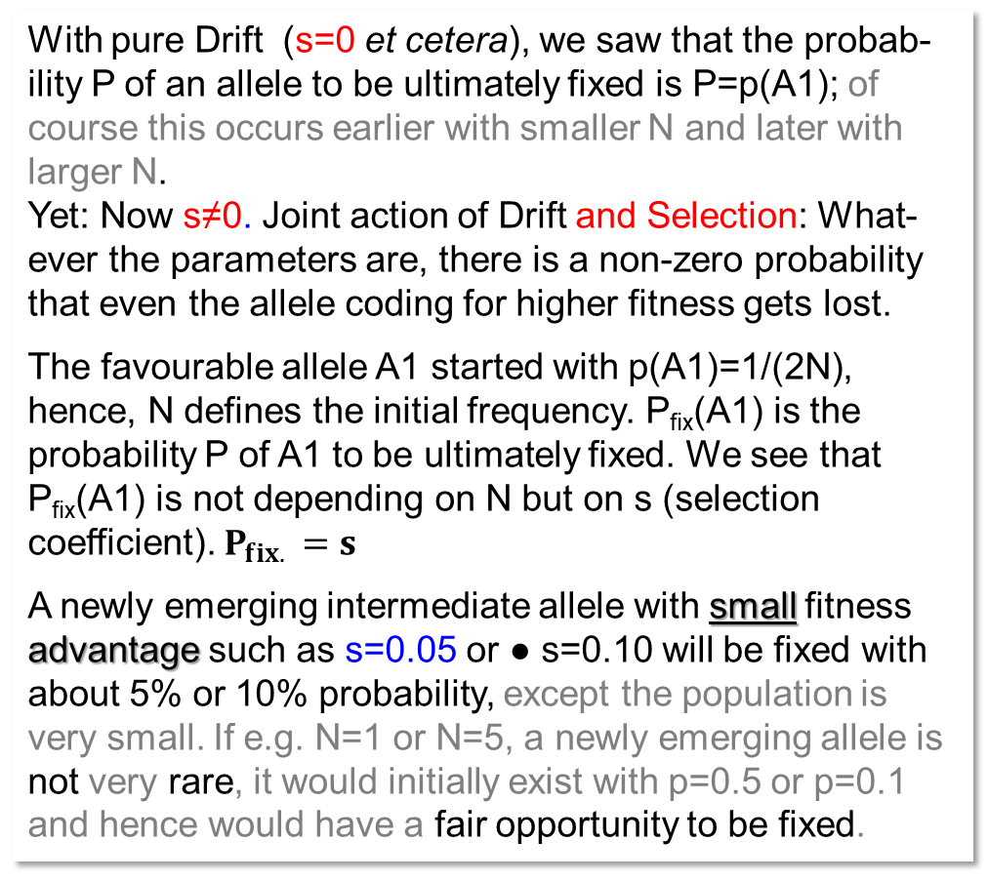
An excellent teacher of Population Genetics: Kent Holsinger, Connecticut, USA. www.academia.edu/2808838/Lecture_Notes_in_Population_Genetics
Superior allele A₁ is initially rare, only 1 in N has it, and only heterozygously, hence P(A₁)_{initial}=1/(2N).
With pure Drift (s=0 et cetera), we saw that the probab-ility P of an allele to be ultimately fixed is P=p(A1); of course this occurs earlier with smaller N and later with larger N.
Yet: Now s≠0. Joint action of Drift and Selection: What-ever the parameters are, there is a non-zero probability that even the allele coding for higher fitness gets lost.
The favourable allele A1 started with p(A1)=1/(2N), hence, N defines the initial frequency. P_{fix}(A1) is the probability P of A1 to be ultimately fixed. We see that P_{fix}(A1) is not depending on N but on s (selection coefficient). $P_{fix. }=s$
A newly emerging intermediate allele with small fitness advantage such as s=0.05 or ● s=0.10 will be fixed with about 5% or 10% probability, except the population is very small. If e.g. N=1 or N=5, a newly emerging allele is not very rare, it would initially exist with p=0.5 or p=0.1 and hence would have a fair opportunity to be fixed.
0.7
0.6
0.5
s=1.0
0.4
s=0.5
Probability P_{fix}(A₁
s=0.2
0.3
s=0.1
s=0.05
s=0.01
0.2
0.1
0.0
0
12
24
36
48
60
72
84
96
108
120
132
144
N, population size
P_{fix} ≈ s
17

Slide 18
On the next pages... a different rule applies to the initial frequency P_{initial}(A1).
On the previous pages only one individual in the population had it, and only in heterozygous status ... but now: "P(A1)_{initial} ≠ 1/(2N)"...
We saw a (decreasing and then) stable probability of ultimate fixation ... Because the value of P(A1)_{initial} =1/(2N) became smaller (A1 rarer) as N increased and A1 was therefore more likely to be lost... and this then became balanced by... the larger N (the smaller impact of Drift)... hence the increasing probability that even a rare allele will persist, so: s was the only parameter that decided what happened. Well, next pages, not so much anymore.
Now, in the next pages …
the initial frequency is p(A1); this value is set, and we now look on what happens if we increase N (I mean, of course, N_{e}). What is the change in the probability of ‘favourable alleles will ultimately reach fixation’. Now, the larger N, the less impact of Drift, the higher the probability that the ‘better’ alleles gets fixed even if starting with low initial frequency. With zero Drift, of course the better alleles gets always fixed!
N_{e}!? ... Re-visit UNPLAB-PopGen_Ch-5[Drift II] page 12
18

Slide 19
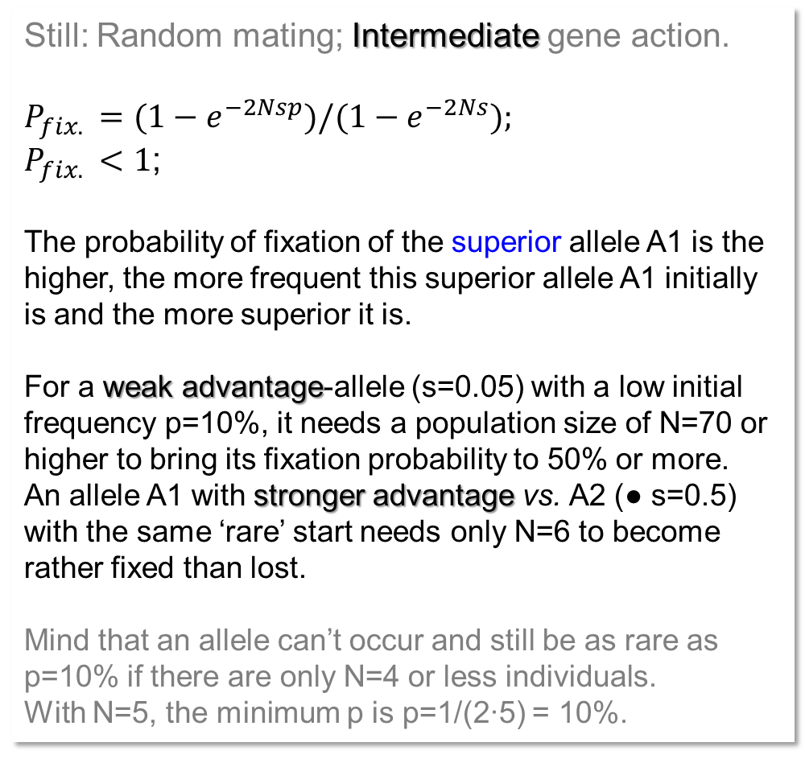
Based on www.academia.edu/2808838/Lecture_Notes_in_Population_Genetics
Superior allele A1 with initial frequency: See legend.
Still: Random mating; Intermediate gene action.
$${P_{fix. }=(1−e}^{−2Nsp})/{(1−e}^{−2Ns});$$
$P_{fix. }<1$;
The probability of fixation of the superior allele A1 is the higher, the more frequent this superior allele A1 initially is and the more superior it is.
For a weak advantage-allele (s=0.05) with a low initial frequency p=10%, it needs a population size of N=70 or higher to bring its fixation probability to 50% or more.
An allele A1 with stronger advantage vs. A2 (● s=0.5) with the same ‘rare’ start needs only N=6 to become rather fixed than lost.
Mind that an allele can’t occur and still be as rare as p=10% if there are only N=4 or less individuals.
With N=5, the minimum p is p=1/(2∙5) = 10%.
1.0
0.9
0.8
0.7
0.6
0.5
Probability of ultimate fixation of Allele A1
0.4
p(A1)=0.1; s=0.05
0.3
p(A1)=0.2; s=0.05
p(A1)=0.5; s=0.05
0.2
p(A1)=0.1; s=0.5
0.1
p(A1)=0.2; s=0.5
p(A1)=0.5; s=0.5
0.0
0
12
24
36
48
60
72
84
96
108
120
132
144
Population size N
19
19

Slide 20
Based on www.academia.edu/2808838/Lecture_Notes_in_Population_Genetics
Superior allele A1with initial frequency: see legend.
1.0
The probability of fixation is the higher, the more frequent the superior allele initially is and the more superior it is.
What is the probability that the favourable allele becomes fixed at multiple loci simultaneously, when both Drift and Selection are acting?
With 12 loci, each starting at p=0.2 and with only s=0.05, it needs N=144 to have a 50% probability for this rare allele to become fixed at each of 12 loci. Again: It needs N=144 as population size to have 50% of repeated such small populations being fixed* for all 12 of a given set of 12 loci (commonly starting with p=0.2 and at each locus s=0.05, and Random Mating and intermediate gene action).
When starting at p=0.1 yet Selection being stronger ( s=0.5), then N=29 suffices to see a 50% probability of fixation of the small populations at each locus, and with N>70, the probability of fixation at each of 12 loci gets higher than 99%.
0.9
simultaneously
0.8
0.7
0.6
Prob.of fix. of "A1" at 12 loci simultaneously
0.5
0.4
p(A1)=0.1; s=0.05
0.3
p(A1)=0.2; s=0.05
p(A1)=0.5; s=0,05
0.2
p(A1)=0.1; s=0.5
0.1
p(A1)=0.2; s=0.5
p(A1)=0.5; s=0.5
0.0
0
12
24
36
48
60
72
84
96
108
120
132
144
Population size N
20
*Fixed. You know: All individuals of such a small population are same and homozygous (Here: For favourable allele).

Slide 21

You may want to again compare the
diagrams and curves on pages 16 and 17 with the
diagrams and curves on pages 19 and 20.
The common topic is “Random Genetic Drift and Selection* co-occur”.
But first, the assumption was p(A₁) = $\frac{1}{2N}$, this means that the smaller the initial population is (big Drift-impact), the higher is ‘automatically’ the initial frequency of A1 (better opportunity for A1 to not be lost). This is balanced so that the probability to become fixed in more or less independent from N (and hence only dependent on S): P_{fix}(A₁) = s
Now, second, we do not have this tricky connection between N and p(A1)_{initial}.
We just have s and N and p(A1)_{initial}. The outcomes are as expected: With larger s and larger N and larger p(A1)_{initial}, the probability that the good allele ‘wins’ is large. With smaller s and smaller N and smaller p(A1)_{initial}, its fate is more dictated by Drift.
*intermediate gene action is assumed throughout
21

Slide 22
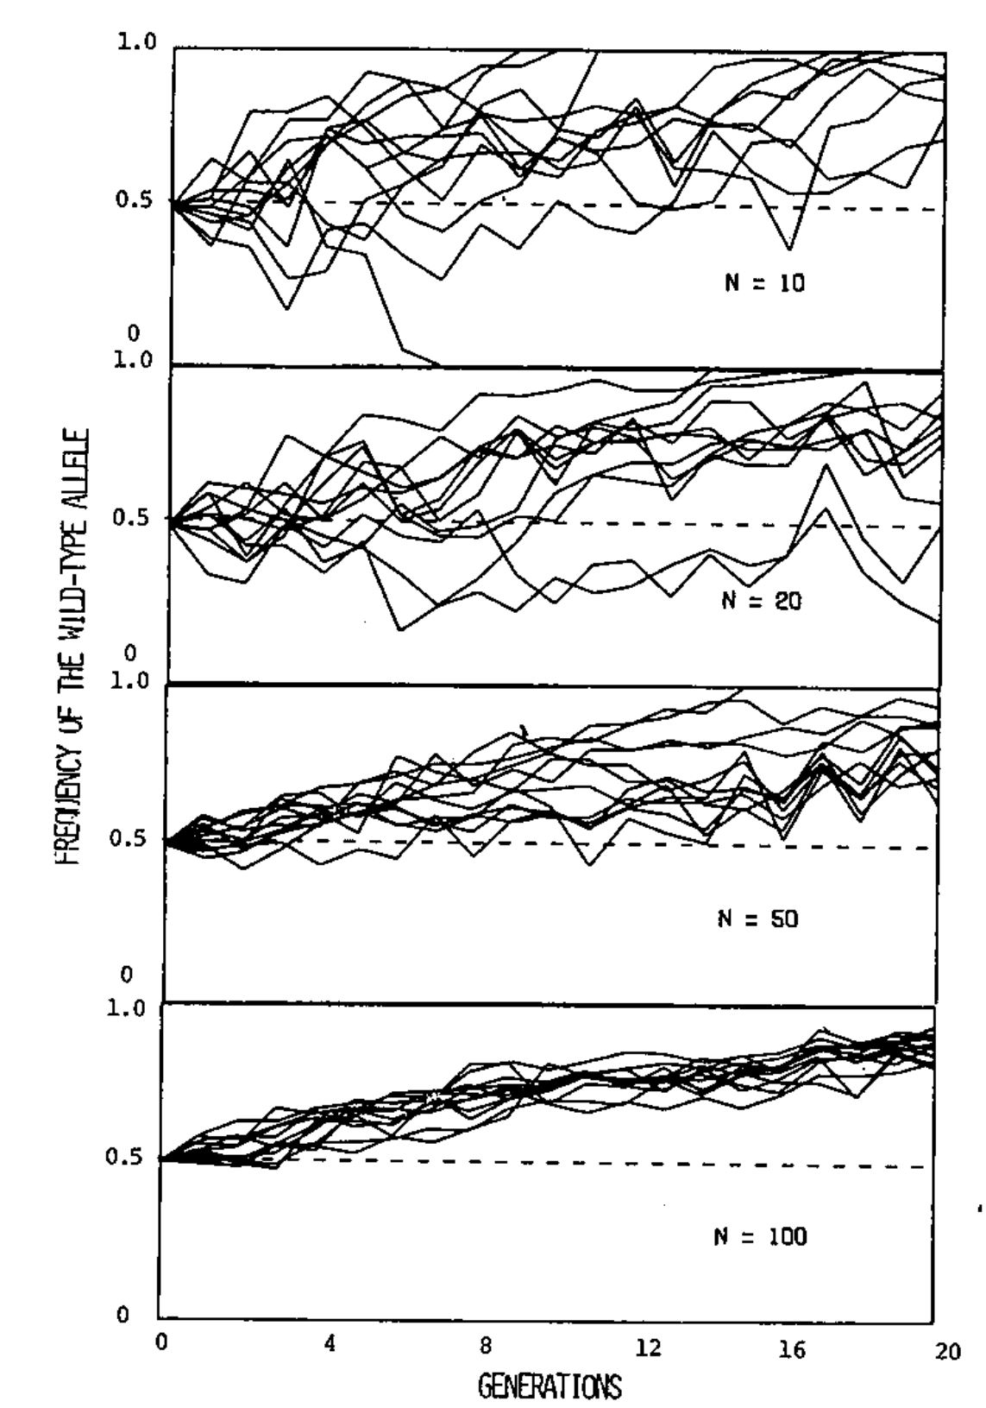
Experimental evidence on the result of joint action of Drift and Selection (Rich, Bell, Wilson, 1979: Genetic Drift in small populations of Tribolium. Evolution 33, 179-584. https://doi.org/10.1111/j.1558-5646.1979.tb04711.x)
N=10
Random Drift of a colour gene in Tribolium castaneum (red flour beetle). Population sizes were chosen with either N=10 or N=20 or N=50 or N=100; and with 12 subpopulations each. Heterozygous individuals could unambiguously be identified by their brown body colour, intermediate between the homozygous red and the homo-zygous black phenotypes.
Natural Selection favoured the wild-type body colour allele (‚red‘) and led to an overall increase in its frequency. Yet, random genetic Drift caused variation between the 12 subpopulations around the mean allele frequency. This variation is more marked if the subpopulations were smaller than if the were larger.
See that in the top-shown scenario (N=10) one subpopulaiton became fixed for the unfavourable colour allele, and with N=20, probably one of the 12 subpopulations would have been fixed for the unfavourable allele, too, if the experiment went longer than its 20 generations.
In none of these cases, the allele frequency was stable across generations. In ‘harsh’ cases, even the favourable allele can be lost.
N=20
Frequency of the wild-type allele
N=50
1
N=100
22
Number of generations
0
4
12
20

Slide 23
We have now seen quite a bit of the field of Population Genetics.
With a focus on Hardy-Weinberg Equilibrium and on the forces that may push a population away from that status.
Forces:
● Non-random mating (we focussed on self-fertilization)
● Drift (gametes that ‚make‘ the next generation are too few in numbers to be really a representative sample of the parental generation)
● Selection (you anyway know …);
● Mutation (your anyway know …)
● Migration (well, was just mentioned).
In the next chapter, we will focus on an ‘Equilibrium’ which is not the HWE but – especially in modern times – even more important that that one*.
*if that is possible at all
23

Slide 24

From here you may go to UNPLAB-PopGen_Ch-9[LD I]
Do not ask me why ‘it’ wrote Push and Pull and gave the arrows the same direction. It is a Large Language Model and has not clue about the real world and its physics,
I assume so.
24
24

